Slide 1

Drama At Cornwallis Academy
Year 7 – LESSON 6
Lesson Objective:
To know what Devising from a Stimuli is.
To understand how to devise a performance using a stimuli.

Slide 2
Level | Drama Strand
 | Creating | Performing | Reflecting
Entry | I can take part in a drama activity | I can participate in part of a group performance | I can identify positive and negative aspects within my work
1 | I can take part in a range of drama activities I can explore problems in an imagined world and make up plays from stories or other stimuli | I can participate in a short group performance I show some consideration of movement and voice in performance | I can make simple connections between the dramas I experience and my own life I can recognise when my own work and the work of others’, could be improved
2 | I can perform my own simple scenes, demonstrating an understanding of drama techniques | I can use my voice and body to create a simple character I can act out improvised dramas | I can talk about why I made certain decisions in my play I can show a basic understanding of how meaning can be shown
3 | I can establish a character with control over movement and voice I can use the dialogue in existing texts as well as creating my own I can devise plays from a range of stimuli I can respond to the use of drama techniques to deepen the role or understanding of the situation e.g. hot seating I can sustain a defined character for a reasonable amount of time | I can learn lines and organise simple performances | I can give suggestions on how work could be improved I can talk about my work using some technical drama terminology I can discuss and give reasons for my preferences in the drama I have seen

Slide 3
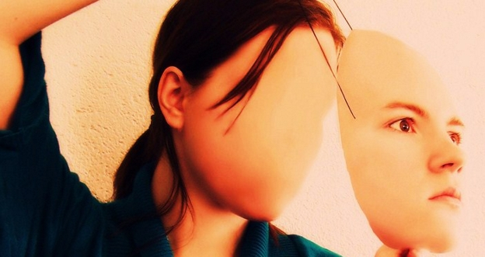
What is a Stimuli?
Lesson Objective:
To know what Devising from a Stimuli is.
To understand how to devise a performance using a stimuli.
A Stimuli is a given starting point for a piece of Drama
This could be….
A picture
An object
A script
A piece of music

Slide 4
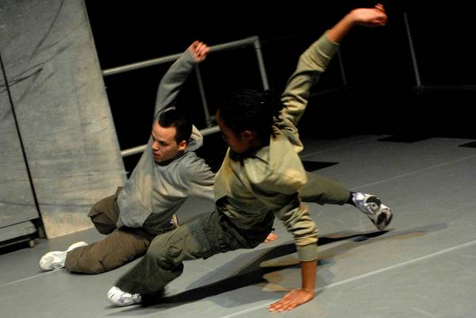
WHAT IS DEVISING?
Lesson Objective:
To know what Devising from a Stimuli is.
To understand how to devise a performance using a stimuli.
Devising is a form of theatre where the piece originates from collaborative, usually improvisatory, work by a group of people (usually the performers)
By the time a devised piece is presented to the public, it usually has a fixed form: the improvisation is confined to the creation process, and either a writer, a director, or the performers themselves, will have decided exactly what is to be included and the running sequence.

Slide 5
IN SIMPLE TERMS
Lesson Objective:
To know what Devising from a Stimuli is.
To understand how to devise a performance using a stimuli.
Devising is when you make a piece of theatre from a given starting point, you then rehearse it and perform it.

Slide 6


WHERE COULD WE GO FROM HERE?
Lesson Objective:
To know what Devising from a Stimuli is.
To understand how to devise a performance using a stimuli.
If we were devising from these images, where could we go?

Slide 7
ASSESSMENT
Lesson Objective:
To know what Devising from a Stimuli is.
To understand how to devise a performance using a stimuli.
Students will be placed into groups.
Students will be given 10 minutes to create and rehearse a small scene from their chosen stimuli.
All scenes must include STILL IMAGE, NARRATION and THOUGHT TRACKING.
Students will perform their pieces to the class.
Students will be recorded when performing for assessment purposes.
If you feel need small amount of help (starting points) to start pick GREEN.
If you feel need a fair bit of help (a whole idea) when in groups pick YELLOW.
If you feel don’t need any help when in groups pick BLUE.

Slide 8




STIMULI
Lesson Objective:
To know what Devising from a Stimuli is.
To understand how to devise a performance using a stimuli.
Each group must choose one of the stimuli on this slide and devise a piece of theatre from it. Each piece must contain at least one STILL IMAGE and the use of NARRATION & THOUGHT TRACKING.

Slide 9

SHOW & TELL
Lesson Objective:
To know what Devising from a Stimuli is.
To understand how to devise a performance using a stimuli.
Watch each groups piece.
Discuss how each group arrived at their pieces from the given stimuli.

Slide 10
SPOTLIGHTING
Lesson Objective:
To know what Devising from a Stimuli is.
To understand how to devise a performance using a stimuli.
Spotlight all groups and observe their work.
WWW – What Went Well?
What worked and why?
What could be improved? And why?

Slide 11
Lesson Objective:
To know what Devising from a Stimuli is.
To understand how to devise a performance using a stimuli.
Summing up:
What is a Stimulus?
What is Devising?
Why are these skills useful in Drama?

